Slide 1


Title
Subtitle Presenter – Instructor Name
How to Crack CFA Level 1 Exam!
Presenter – Ankur Kulshrestha

Slide 2
What will you learn today…?
The Instructors- Led by FinStudyClub Powered by Wiley
CFA Level 1 Introduction
Who should write it?
How to prepare for it?
The Refresher Course: Your Success Mantra
Sample Class: FRA: Cash Flow Statement (R27)
Q & A Sessions

Slide 3




The Instructors
Ankur is a veteran CFA trainer- 7 years, 70 batches of training experience
Has worked in Corporate Finance (Suzuki), in consulting (E&Y), valuation assignments
Is a serial ranker- University, Chartered Accountancy and is a swimming buff☺
Domain specialist- FRA, Corporate Finance, Equity, Ethics
Dabbled with corporate banking, equity research and strategic finance
Taught finance, accountancy, cost accounting, mathematics…know bit of everything
Aced various exams and doing so, discovered my strength
Help students prepare and crack exams! CA, CFA, FRM, MBA…am there☺
Ankur Kulshrestha, CFA, ACA
Powered by
Amit Parakh-CFA, ACA, CS, FRM,
PGDM (IIM A)

Slide 4
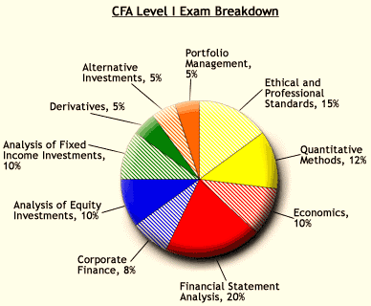
CFA Level 1 Introduction
About CFA Level I
Marks your entry into the CFA program
Covers areas like:
Ethics,
Quants, FRA, Corporate Finance, Economics
Equity, Fixed Income, Derivatives, Alt. Assets
Portfolio Management
Weightage almost spread across between 5%-15%
Sectional Cut-offs

Slide 5
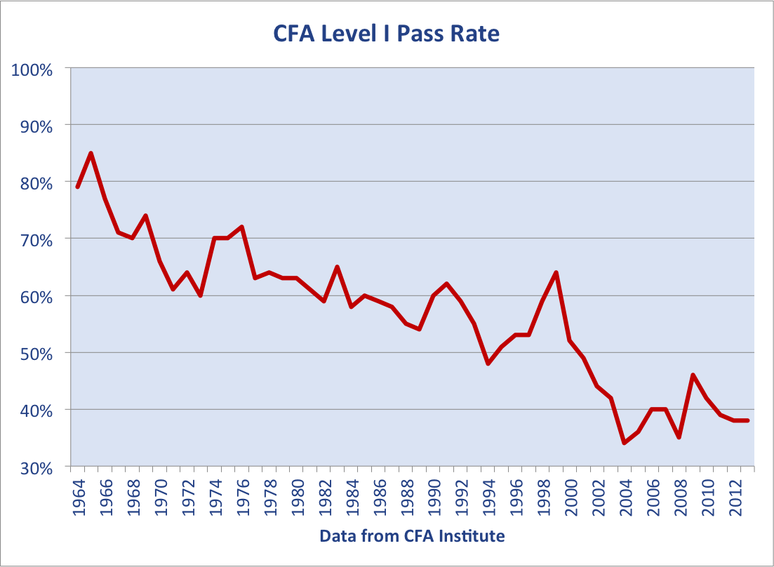
CFA Level 1 Introduction (Contd.)
What is the exam like?
Level I has two paper- AM and PM
MCQs. Nothing to lose.
120 questions. 180 minutes. Game on.
Nearly 35-40 % pass rate
No hurdle score, maximise your chances
Apply common sense on what you know and on what you don’t.

Slide 6

Who should write the exam?
Are you interested in the investment industry?
Are you in the final year of your college?
Want to get into banking/investment/ research/ investment banking profile?
Looking out for the best self study course in finance?
Your passport for international investment industry
Gold Standard

Slide 7



How to prepare for the exam?
350-400 hours is good. And a day has 24 hours!
Spread it across 2 months
Take along a few topics
Watch and listen to the Video tutorials
Back to back practice

Slide 8
The Refresher Course: Your Success Mantra
8 weekends, 50 hours of face-time with expert trainers from
Live Webinars on Crucial topics across all subjects: 80:20 rule
Accompanied with lots of practical examples
‘Not-so-important’ topics also covered through online recorded tutorials: Comprehensive Coverage
Includes Wiley’s Test bank with more than 500 Qs. & Two Mock Exam: Exam Oriented
Powered by

Slide 9
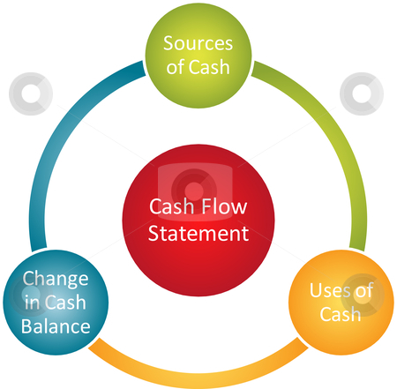
Sample Class: Cash Flow Statement
Reading 27

Slide 10
Cash Flow Statement
Cash Flow Statement provides information about sources and uses of cash of the firm. It provides information to assess firm’s liquidity, solvency and financial flexibility.
All cash flows are classified into the following categories:
Cash flow from operating activities (CFO)
(Net Income related cash transactions)
Cash flow from investing activities (CFI)
(Cash transactions related to LT assets & investments)
Cash flow from financing activities (CFF)
(Cash transactions affecting capital structure)
Operating cash flow
+Investing cash flow
+ Financing cash flow
= Change in cash balance
+ Beginning cash balance
= Ending cash balance

Slide 11
Cash from Operating Activity (CFO)
Cash flows from regular business / incidental transactions
Inflows
Collection from customers
Interest and dividend income from investments
Proceeds from sale of trading securities
Tax refund
Outflows
Payment to suppliers
Payment for other expenses
Interest paid on loans / debentures
Purchase of trading securities
Taxes paid (in relation to any transaction)
Most Important

Slide 12
Cash from Financing Activity (CFF)
Cash flows related to capital structure of the organization
Inflows
Issuance of shares
Receipt of loan from financer
Issue of debentures
Outflows
Payment for debentures
Buy back of stocks
Loan repayment
Dividend paid to shareholders

Slide 13
Cash from Investing Activity (CFI)
Cash flows related to Acquisition of long term assets + non trade investments
Inflows
Sale of PPE
Sale of investments other than trading securities
Receipt of installment of loan given by organization
Outflows
Purchase of PPE
Acquisition of investment other than trading securities
Loans made to others

Slide 14
Lets Practice
Apple Inc. had the following transactions during 2014:
Purchased new fixed assets for $70,000
Converted $75,000 worth of preferred shares to common shares
Issued Bonus shares of $55,000
Received cash dividends of $14,000
Paid cash dividends of $21,000
Repaid mortgage principal of $17,000
Assuming Apple Inc. follows U.S. GAAP, calculate the different categories of Cash Flows

Slide 15
Clarification on Interest and Dividend
US GAAP
 | Paid | Received
Interest | CFO | CFO
Dividend | CFF | CFO
IFRS
 | Paid | Received
Interest | CFO or CFF | CFO or CFI
Dividend

Slide 16
Clarification on Tax Flows
US GAAP: Taxes on any type of income is to be shown in CFO
IFRS: Income Taxes should be classified as per respective incomes
E.g. Net Book Value of Machine $30,000
Sales Value: $ 35,000, selling cost is $1,000
Tax on income is 30%.

Slide 17
Direct methods of calculating CFO
Preferred under IFRS and US GAAP
Cash book / Bank Account becomes the source of the information
Alternatively, each line item of the income statement (which is based on accrual concept) is converted into cash receipts or cash payments.
Cash received from customers
(-) Cash paid to suppliers
(-) Cash paid for expenses
(-) Interests on loan, etc. paid
(+) Other incomes in cash
(-) Taxes paid in cash
Non-cash items like depreciation & Non-operating items like loss / gain on sale of assets, etc are NOT considered

Slide 18
Indirect methods of calculating CFO
Net income is converted to operating cash flow by making various adjustments
Net Income (as per P/L)
(-) Non cash incomes
(+) Non cash expenses
(-) Non operating incomes
(+) Non operating expenses
(+) Tax provision made
(-) Taxes actually deposited
(+) Increase in current liability
(-) Increase in current assets
Step 1
Step 2
Step 3
Step 4
Under US GAAP, a statement reconciling Net Income and CFO is to be shown in footnotes if Direct Method for CFO is used. This is the reason why most firms prefer following Indirect Method.

Slide 19
Lets Practice
A firm has net cash sales of Rs.3,500, earnings after taxes (EAT) of Rs.1,000, depreciation expense of Rs.500, cost of goods sold (COGS) of Rs.1,500. Also, inventory decreased by Rs.100, and accounts receivable increased by Rs.300. What is the firm's cash flow from operations?

Slide 20
Lets practice
The following information is from the balance sheet of Google Inc.
Net Income for 01/05/2015 to 31/05/2015: Rs.8,000
Using the indirect method, calculate the cash flow from operations for Silverstone Company as of 31/05/2015:
A) Increase in cash of Rs.8,025.
B) Increase in cash of Rs.8,125.
C) Increase in cash of Rs.7,725.
Account | Balance 01/05/2015 | Balance 31/05/2015
Inventory | Rs. 2,000 | Rs. 1,750
Prepaid exp. | Rs. 1,200 | Rs. 1,700
Accumulated Depreciation | Rs. 800 | Rs. 975
Accounts payable | Rs. 425 | Rs. 625
Long term bonds payable | Rs. 650 | Rs. 550

Slide 21
Notes to CFS
CFO is calculated differently under direct and indirect methods but the result remains the same.
Calculation of CFI and CFF is identical under both methods.
Denote cash inflows (sources of cash) as positive numbers and cash outflows (uses of cash) as negative numbers.
Changes in assets and changes in cash flows are inversely related.
Changes in liabilities and changes in cash flows are directly related.
Ignore depreciation under direct method.
Notes payable is short term but since financial in nature - to be treated under CFF.
Bonds payable is a long-term liability and is covered under CFF(ignored for CFO)

Slide 22
Questions
An analyst contemplates using the indirect methods to create the projected statement of cash flows. She decides to research the differences between the direct and indirect methods. Which of the following statements is TRUE? Under the:
Indirect method, changes in accounts receivable are already included in the net income figure.
Indirect method, depreciation must be added to net income, because it is a non-cash expense.
Direct method, depreciation must be added to cash collections because it is a non-cash expense.

Slide 23
Questions
Given the following:
Sales | $1,500
Increase in Inventory | 100
Depreciation | 150
Increase in accounts receivable | 50
Decrease in accounts payable | 70
After-tax profit margin | 25%
Gain on sale of machinery | $30
The cash flow from operations is:
$115
B. $275
C. $375

Slide 24

Certifications
How Edureka course will help you scale up your career
CFA level 1 Exam
Go to www.edureka.co/cfa-level1
Batch starts from 10th October (Weekend Batch)
Timings: 6:00PM to 9:00PM
Wiley's Study Guide Worth INR 30,000 Free!
Edureka's Refresher course for CFA Level 1 course:
Refresher course on CFA Level I Exam focuses on the ten topic areas and prepares you to write the CFA Level 1 Exam
Online Live Courses: 50 hours
Assignments: 15 hours
Lifetime Access + 24 X 7 Support

Slide 25
Thank You
Questions/Queries/Feedback
Recording and presentation will be made available to you within 24 hours

